Slide 1
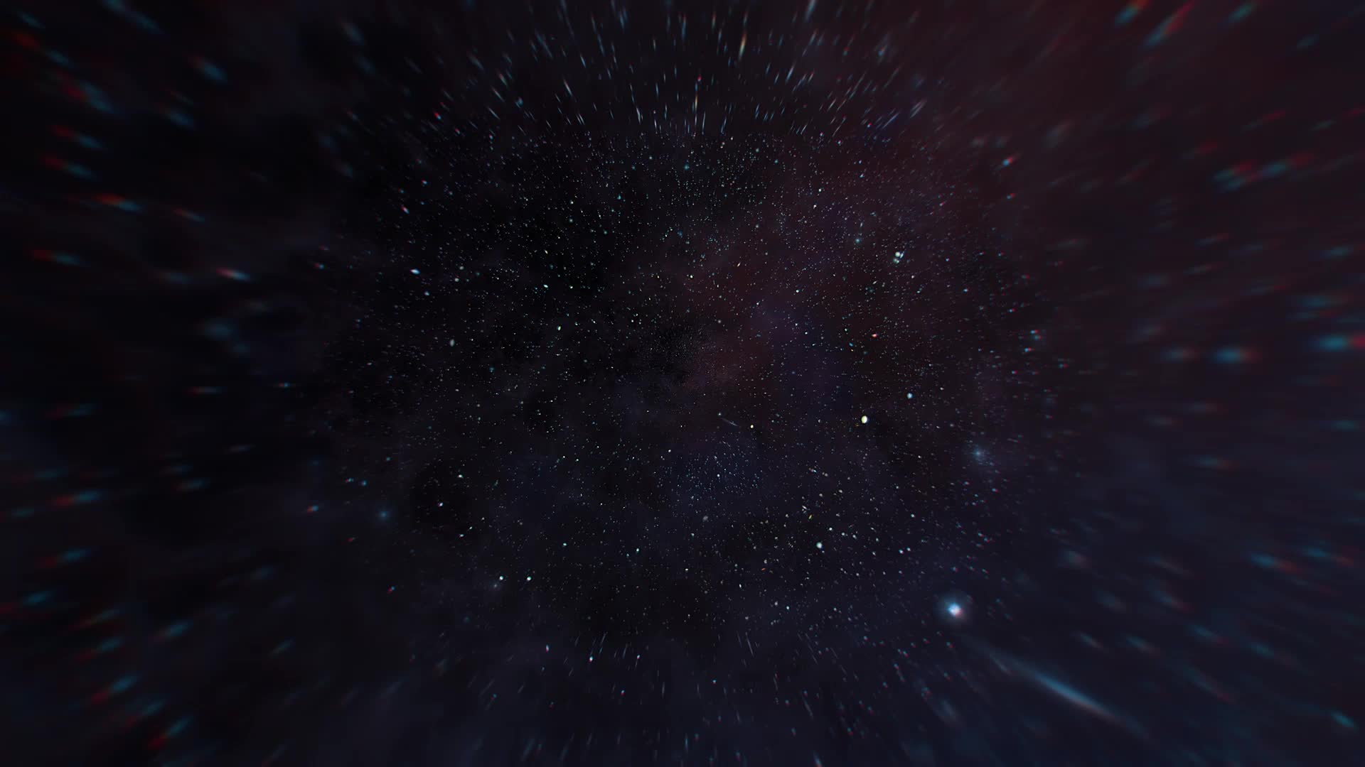

Dark matter & Dark energy: The mysteries of our universe
By Kiran Saroye

Slide 2
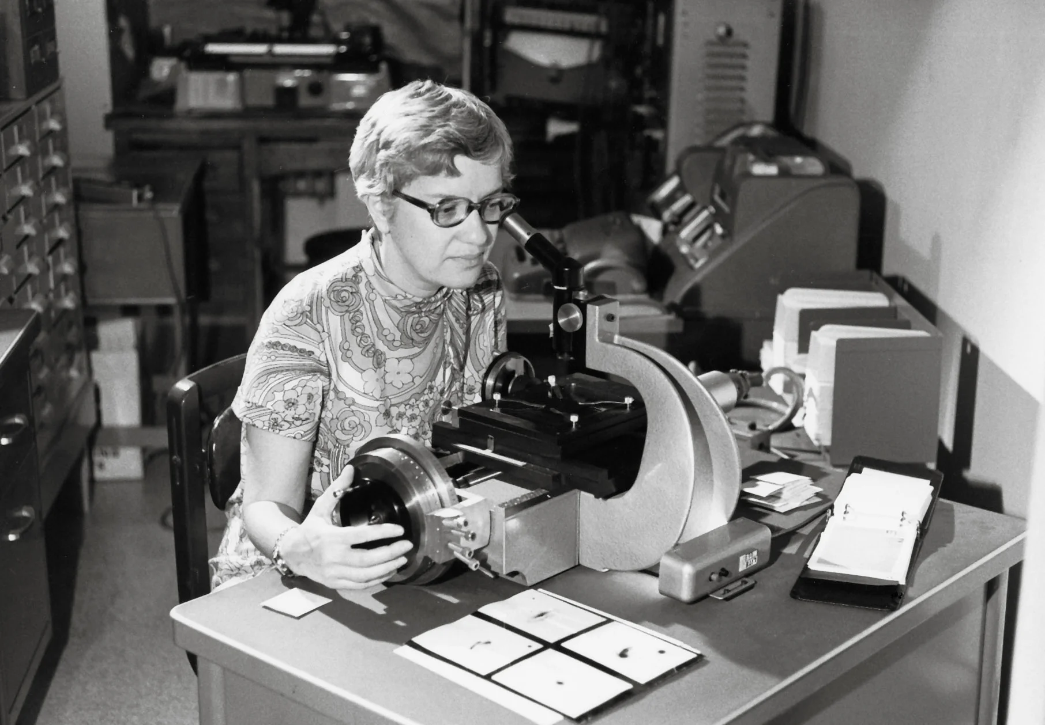
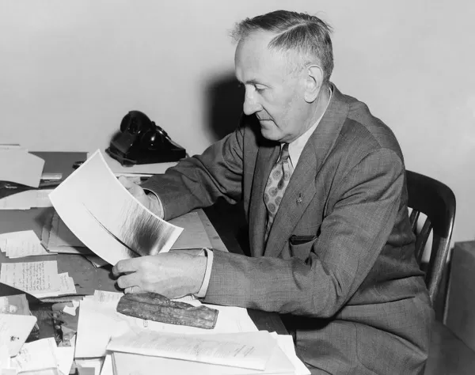
HOW WAS DARK MATTER AND ENERGY DISCOVERED?
Dark matter was first thought of in the early 1930s by a Swiss American astronomer called Fritz Zwicky, who realised that the stars making up the Coma Cluster of galaxies only made up 1% of the mass needed to keep the galaxies from escaping the gravitational pull.
Then during the 1970s, an astronomer named Vera Rubin confirmed that dark matter did exist by looking at the velocities of the inner and outer stars of the Andromeda Galaxy.
Dark energy was discovered when two independent astronomers studied the explosion of white dwarfs where they were able to see the emitted light coming from the blast - the further they were away from them, the dimmer the light coming from the blasts will be.

Slide 3
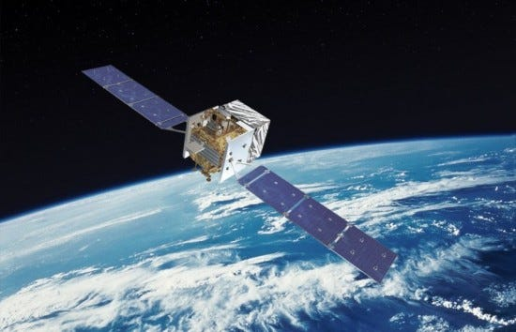
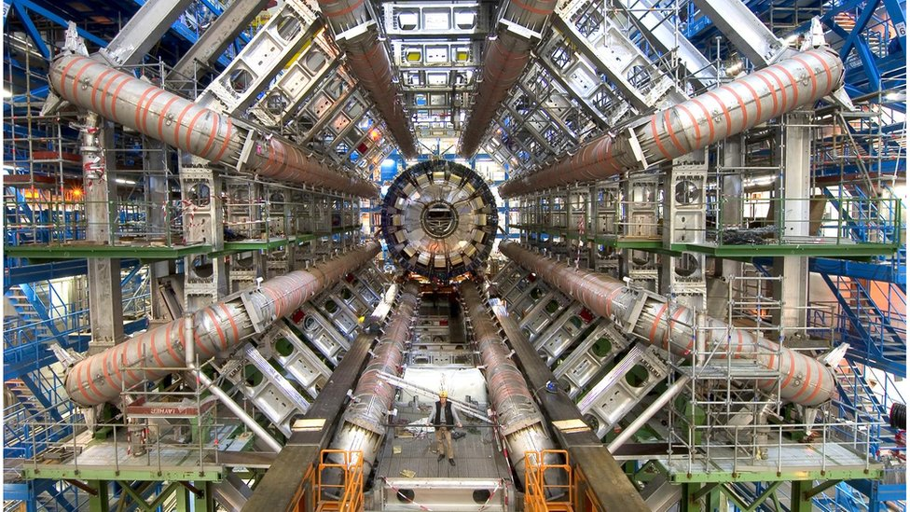
DETECTING DARK MATTER
Annihilation: dark matter particles annihilate their anti-particles.
scattering/direct direction: dark matter scatters off Standard Model Particles, producing a signal that is detected by highly advanced equipment.
Production experiments: the Large Hadron Collider is used to make two particles collide with each other to create dark matter particles along with many other particles.

Slide 4
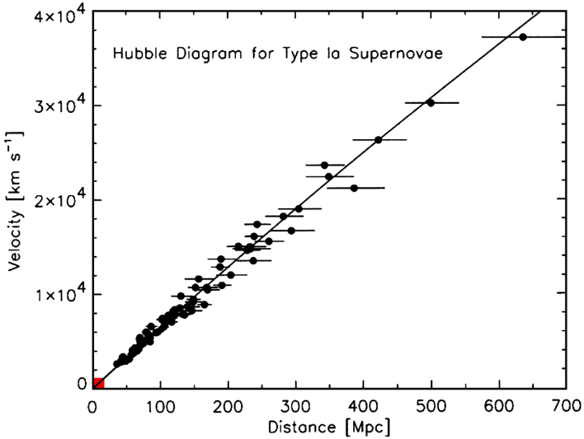
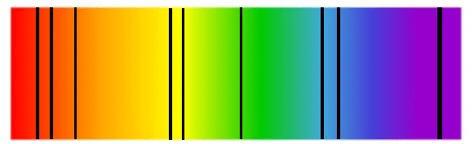
DETECTING DARK ENERGY
Doesn’t seem to be any technology that can allow scientists to see and find dark energy in our universe but can use evidence that the universe is in fact expanding at a rapid rate.
Red shift: is used to figure out how far an object is from Earth where the further the galaxy is, the faster it is moving away from Earth.
The velocity of a galaxy can be found by using the equation v = H x d.

Slide 5
CONCLUSION
Dark matter and energy remains the most challenging topic to uncover about in our universe.
Proving that these forces exist still questions scientists to this day.
There have been advanced equipment produced such as the Fermi Telescope and the Large Hadron Collider to study how these forces act/properties they are made up of.
With there being strong evidence that the universe is accelerating at a fast rate, it is still indirect proof that dark energy exists.

